Slide 1
5G and Beyond interview

Slide 2


Slide 3
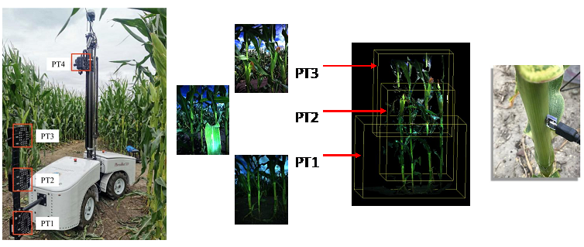
https://arawireless.org/research/agriculture-use-case/

Slide 4
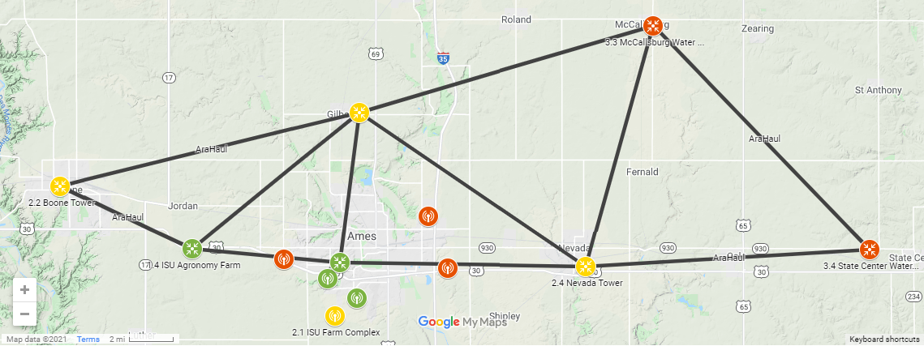

Slide 5
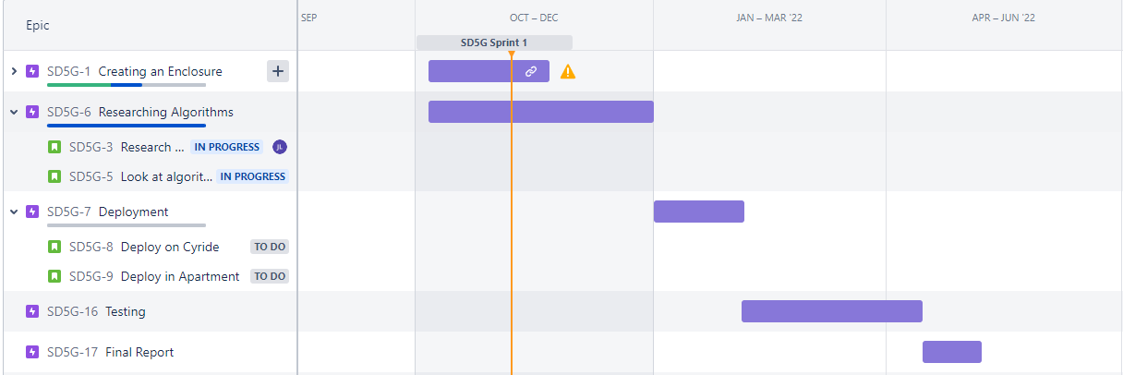

Slide 6


